Slide 1
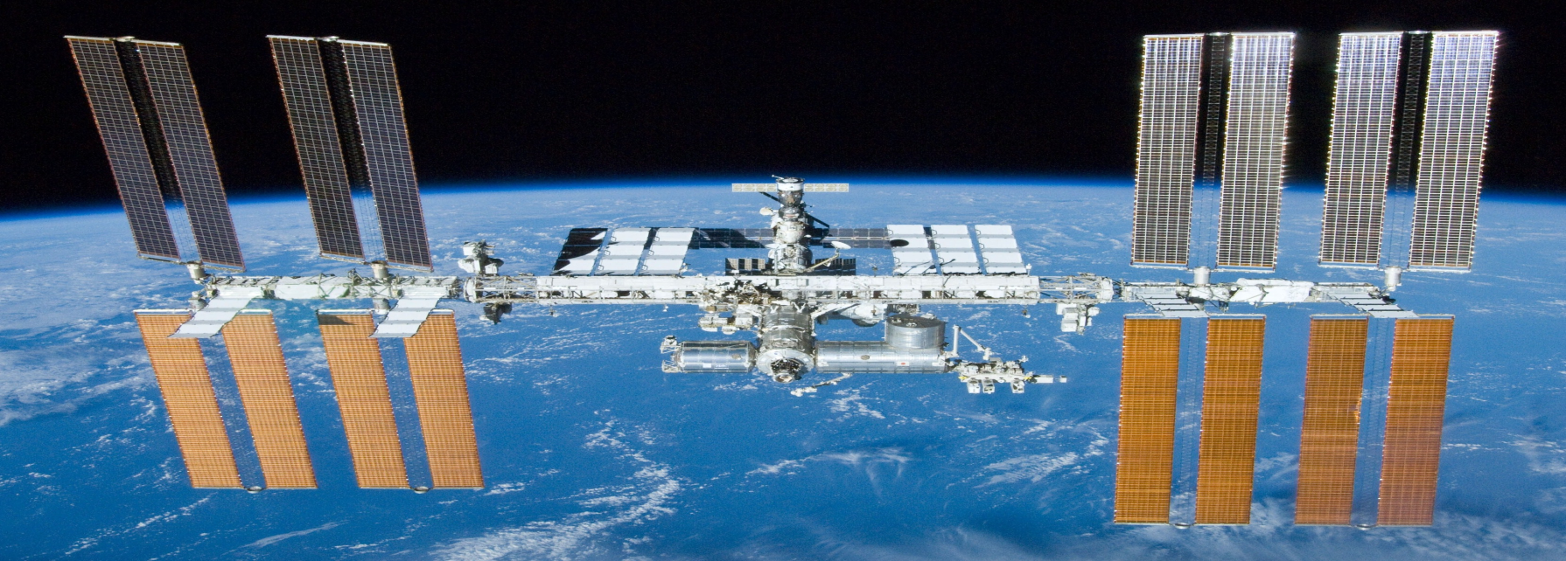
The international space station (ISS)

Slide 2
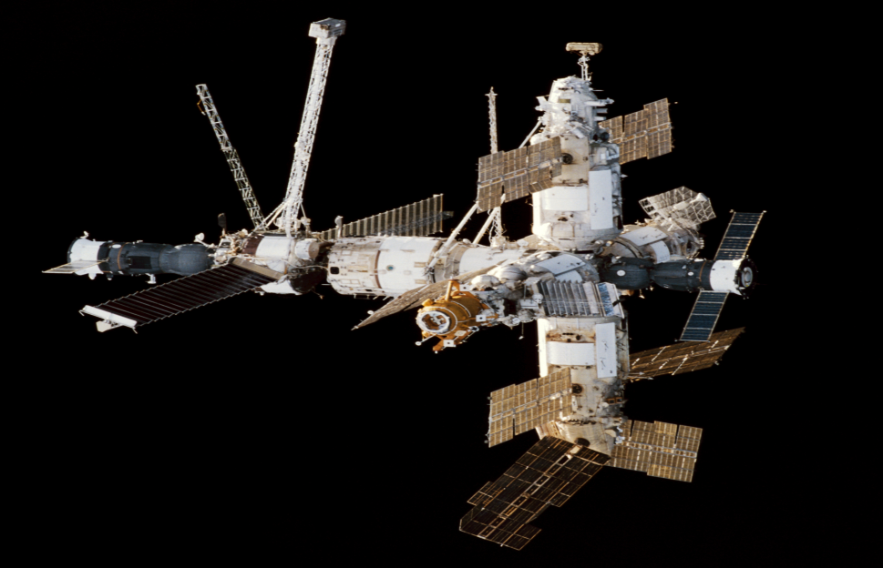
Stations before ISS.
Let’s start with Mir-1,
a Russian space station
(1981-2001).
This station was built for
scientific projects in
space.

Slide 3
“Salyut” stations.
There was 7 “Salyut” stations:sal-1,sal-2,sal-3,sal-4,sal-5,sal-6.etc.
Not all of “Salyut” stations had successfull mission.

Slide 4
What's the ISS?
The ISS is the international space station,wich
was made with 18 countries, but the principals
are the U.S. and Russia.
The international space station (2004-)
The ISS is designed for scientific projects.
Example: trying to grow plants, transfer sun energy to electric and test new technology.

Slide 5
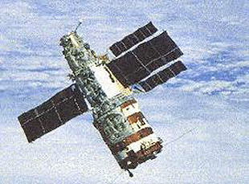
Thanks for listening.

